Slide 1






PDS
Computer Vision
Intro
to
Cloud
@ P. Siagian
https://github.com/siagianp
https://www.youtube.com/@AmelOline/videos
https://github.com/amelcharolinesgn2/IoT_simulator-mqtt-NodeRed
https://github.com/amelcharolinesgn2/Cloud-Infrastructures
https://github.com/amelcharolinesgn2/ClouD-Infrastructure-SISKA-2025
https://github.com/amelcharolinesgn2/Gyroscope-Sensor-Data-Accelerometer
https://github.com/amelcharolinesgn2/cloudSim
https://github.com/amelcharolinesgn2/CCNA 1
Notes:
data communication simulator
https://github.com/yetanalytics/datasim
Quantum Communication Simulator
https://github.com/Slygriyrsk/quantum-communication-simulator
MIL-STD-1553-Simulator
MIL-STD-1553 is a serial communication protocol that is used in spacecrafts for internal communication. A spacecraft consists of various components like main computer, star tracker, fly wheel, temperature sensor, cameras (also called as Remote Terminals) etc. The main computer needs to communicate with all the other peripherals to get the data and send it to ground station for further processing. This internal communication is done by a serial bus called MIL-STD-1553. This repository contains a simulation for this protocol. It can be used to create any space applications by importing the simulator into your code.
MIL-STD-1553 has Bus Controller that orchestrates the transmission and reception of data on the serial bus. It always initiates the communication and commands Remote Terminal for sending or receiving data. Only one node or Remote Terminal can send data on the bus at a given moment when ordered by the Bus Controller. The details of the protocol can be found in MIL-STD-1553 Tutorial and Reference document by Alta dt.
About This Repository:
This repository segregated based on various components that are described in the MIL-STD-1553 standard. Two of the most important components are Bus Controller and Remote Terminals. For a small network, one serial bus can handle up to 31 remote terminals and one bus controller. This repository is divided into two parts. Bus Controller Simulator and Remote Terminal Simulator. Both the components have separate set of functionalities.
Bus Controller Simulator : This simulator is responsible to understand the requirements from the Flight Software or Spacecraft computer and send commands and data to Remote Terminal.
Remote Terminal Simulator : This simulator is responsible for understanding the commands or data comming from the Bus Controller and send status and data based on the requirements sent by the Bus Controller.
How To Use This Simulator
https://github.com/ShubhankarKulkarni/MIL-STD-1553-Simulator
This simulator uses ethernet communication instead of the actual physical communication that is mentioned in the standars. The standard is developed taking harsh and noisy conditions into account. The simulator majorly focuses on data layer of the standard. Based on this, you can either deploy both the simulators on the same machine and test it over the local loopback or you can deploy separate simulators on separate machines in a single subnet or same network.
You can run the following commands to run the simulators
python BC_Simulator.py
python RT_Simulator.py
python Simulator.py
Or you can uncomment a section of code in Simulator.py that creates threads for Bus Controller Simulator and Remote Terminal Simulator and then run the following command
python Simulator.py
Simulator.py only provides an example of how you can use BC and RT simulators. You can replace Simulator.py by any space application that needs to transfer any data using MIL-STD-1553. Apart from that, this whole repository is developed as a module. So, you can simply clone the repository into your application and can import it.
Arikatakur/Network-Transmission-Simulator
https://github.com/Arikatakur/Network-Transmission-Simulator
imulates network data transmission using the Stop-and-Wait protocol with acknowledgment packets. It includes:
Theoretical Calculator: Computes the time required to send a file under ideal conditions.
UDP File Transfer Tools: Sends files over a network using UDP and logs transmission details.
Experimentation Framework: Measures and compares theoretical vs. actual transmission times.
Features
Command-line interface for both theoretical calculations and actual file transmission.
Logs packet transmission details, acknowledgments, and final results.
Javadoc documentation for all classes and methods.
Test cases for robust verification.
Requirements
Java Development Kit (JDK) version 8 or higher.
Two computers on the same network for experimentation.
Tools:
iperf for bandwidth measurement.
Wireshark for packet analysis.
Design of data communication networks using simulation techniques
A Simulator for FANETs Using 5G Vehicle-to-Everything Communications and Named-Data Networking
https://arxiv.org/html/2510.13823v1

Slide 2


Cloud Computing

Slide 3
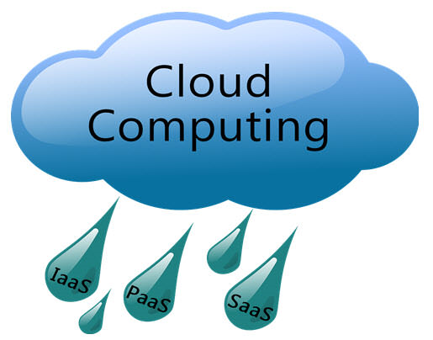

Slide 4
Module Outline
Fundamental concepts of Distributed Systems
Cluster Computing
Grid Computing
Cloud Computing
Mobile Computing

Slide 5
What is computing?
Computing is the process of using computer technology to complete a given goal-oriented task.
Computing may encompass the design and development of software and hardware systems for a broad range of purposes - often structuring, processing and managing any kind of information
to aid in the pursuit of scientific studies, making intelligent systems, and creating and using different media for entertainment and communication.
the use of a computer to process data or perform calculations.
It has scientific, engineering, mathematical, technological and social aspects.
The list is virtually endless, and the possibilities are vast

Slide 6
What is Distributed sysem?
A distributed system, also known as distributed computing, is a system with multiple components located on different machines that communicate and coordinate actions in order to appear as a single coherent system to the end-user.
Example -
Telecommunication networks: Telephone networks and Cellular networks.
A massively multiplayer online game (MMOG, or more commonly, MMO) is an online game with large numbers of players, often hundreds or thousands
World wide web

Slide 7
Distributed Systems :
A brief introduction
A collection of independent computers that appears to its users as a single coherent system.
Features:
  No shared memory
  Message-based communication
  Each runs its own local OS
  Heterogeneity
Ideal: to present a single-system image:
  The distributed system “looks like” a single computer rather than a collection of separate computers.

Slide 8
Distributed Systems :
A brief introduction
Distributed system: the hardware and software of a collection of independent computers that cooperate to realize some functionality
–usually, individual parts cannot realize that functionality just by themselves
–may be serving a user (...ultimately)

Slide 9
Centralized System Characteristics
On-Cs-Ra-S-P-P
One component with Non-autonomous parts
Components shared by users all the time
All Resources accessible
Software runs in a single process
Single point of control
Single point of failure

Slide 10
Distributed System Characteristics opposite of Centralised..
Multiple autonomous components
Components are not shared by all users
Resources may not be accessible
Software runs in concurrent processes on different processors
Multiple points of control
Multiple points of failure

Slide 11
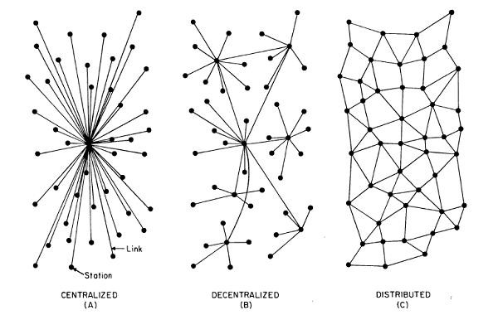

Slide 12
Distributed System Characteristics
(SEAM)
To present a Single-system image:
  Hide internal organization, communication details
  Provide uniform interface
Easily Expandable
  Adding new computers is hidden from users
Continuous Availability
  Failures in one component can be covered by other components
Supported by Middleware

Slide 13
Advantages of Distributed System over Centralized System(SIRI)
Speed - When used to implement parallel processing where only goal is to achieve
maximum speed on a single problem, distributed systems can achieve very high speed as
compared to the centralized ones.
Inherent Distribution- Another reason for building a distributed system is that some
applications are inherently distributed. Banking, Airline reservation etc. are examples of the
applications that are inherently distributed . When all the branches of a bank are connected,
we have a commercial distributed system.

Slide 14
Contd ..
Reliability- By distributing the workload over many machines, a single chip failure will bring down at most one machine, leaving the rest intact.
For critical applications, such as control of nuclear reactors or aircraft, using a distributed system to achieve high reliability may be a dominant consideration
Incremental Growth- Often a company will buy a mainframe with the intention of doing all its work on it.
If the company prospers and the workload grows, at a certain point the mainframe will no longer be adequate.

Slide 15
Contd ..
The only solutions are to either replace the mainframe with a larger one (if it exists), or add a second mainframe. Both of these can cause management difficulties with the company's operations.
In contrast, with a distributed system, it may be possible to simply add more processors to the system, thus allowing it to expand gradually as the need arises.

Slide 16
Disadvantages of Distributed System
Software: difficult to develop software for distributed systems
Control :Distribution of control
Network: saturation, lossy transmissions
Security: easy access also applies to secret data
Hard to detect faults
Administration issues

Slide 17
What is Cluster Computing?
  A computer cluster is a group of linked computers, working together closely so that in many respects they form a single computer.
  The components of a cluster are commonly, but not always, connected to each other through fast local area networks.
  Clusters are usually deployed to improve performance and/or availability over that provided by a single computer, while typically being much more cost-effective than single computers of comparable speed.
APP
APP
…
APP
Cluster Middle ware
High Speed Local Network
CPU
CPU
…
CPU
Cluster

Slide 18
What is Cluster Computing?
Cluster consists of :
Nodes(master + computing)
Network
OS
Cluster middleware: Middleware such as MPI (Message Passing Interface) which permits compute clustering programs to be portable to a wide variety of clusters
A cluster has two types of computers - a master computer, and node computers.
When a large problem or set of data is given to a cluster, the master computer first runs a program that breaks the problem into small discrete pieces; it then sends a piece to each node to compute. As nodes finish their tasks, the master computer continually sends more pieces to them until the entire problem has been computed.

Slide 19
Types of cluster computing
High Availability (HA) and failover clusters –
These models are built to provide an availability of services and resources in an uninterrupted manner through the use of implicit redundancy to the system.
If a cluster node fails (failover), applications or services may be available in another node.
These types are used to cluster data base of critical missions, mail, file and application servers.
Load balancing (LB) –
This model distributes incoming traffic or requests for resources from nodes that run the same programs between machines that make up the cluster.
If a node fails, the requests are redistributed among the nodes available.
This type of solution is usually used for Web servers .

Slide 20
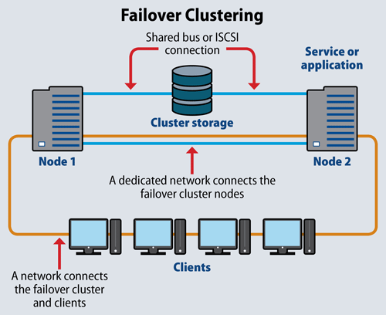
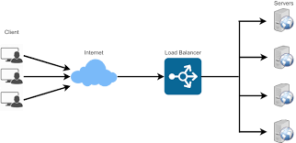
Load Balancing

Slide 21
Types of cluster computing
HA &LB combination –
As its name says, it combines the features of both types of cluster, thereby increasing the availability and scalability of services and resources.
This type of cluster configuration is widely used in web, email, news, or ftp servers.

Slide 22
Cluster Computing
Advantages
Increasing speed – better performance
optimized resources utilization
Can execute Large applications
Disadvantages
Complex programming models
Difficult for debug and development

Slide 23
Grid Computing
Grid Computing was first coined in 1990s by Cart Kesselman & Ian Foster and defined as –
  “Grid computing is coordinated resource sharing and problem solving in dynamic, multi-institutional virtual organizations.”

Slide 24
Grid Computing
Computing grids are conceptually and logically like electrical grids. In an electrical grid, wall outlet allow us to connect to an infrastructure of resources which generate and distribute the electricity. Likewise, in the IT industry, grid computing uses middleware to coordinate distinct IT resources over the network, allowing them to function and work as a virtual whole.
The goal of a computing grid , like that of a electrical grid, is to provide users with access to the resources they need, when they need them and to provide remote access to IT assets and aggregating processing power.
Grid provides a series of distributed computing resources via LAN or WAN to the terminal user’s application, as if he is using a super virtual computer.

Slide 25
Grid computing is the integration of computer resources for achieving similar objective.
Grids are frequently created with middleware software libraries of a common grid.
Grids are a type of dispersed computing system, whereas a virtualized super computer is made from various networked.
Grids focus on two different but associated objectives—supplying isolated access to IT resources and building up processing control.
The grid is a technology which controls two factors—allocation and trust.

Slide 26
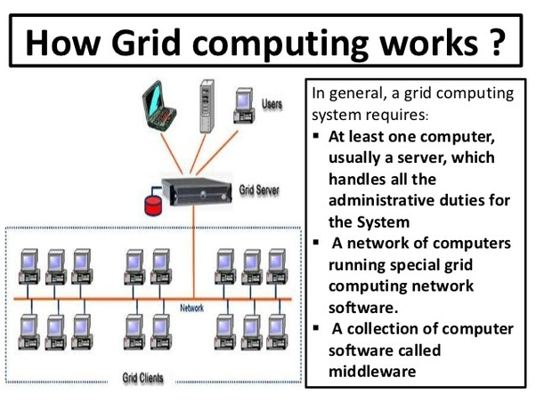

Slide 27
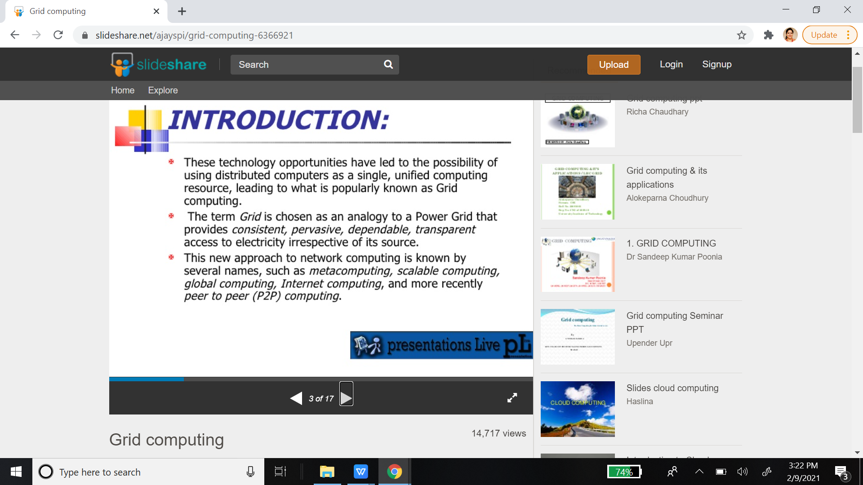

Slide 28
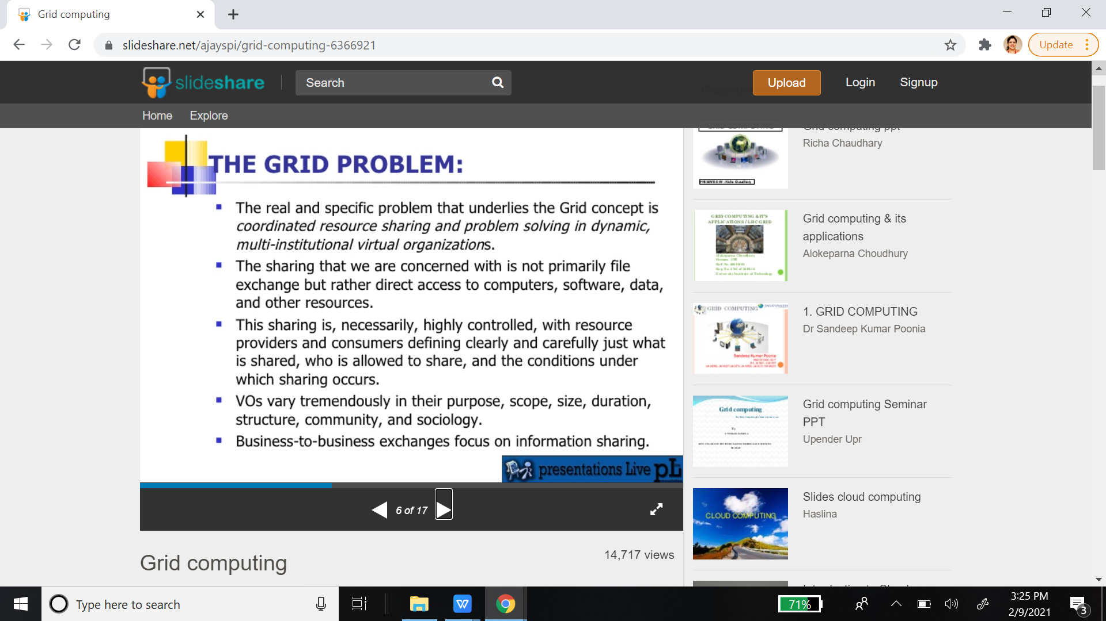

Slide 29
Grid Computing is a subset of distributed computing, where a virtual super computer comprises of machines on a network connected by some bus, mostly Ethernet or sometimes the Internet.

Slide 30
Components in Grid
A Grid computing network mainly consists of these three types of machines
Control Node:
A computer, usually a server or a group of servers which administrates the whole network and keeps the account of the resources in the network pool.
Provider:
The computer which contributes it’s resources in the network resource pool.
User:
The computer that uses the resources on the network.
For controlling the network and it’s resources a software/networking protocol is used generaly known as Middleware. This is responsible for administrating the network and the control nodes are merely it’s executors. As a grid computing system should use only unused resources of a computer, it is the job of the control node that any provider is not overloaded with tasks.

Slide 31
Another job of the middleware is to authorize any process that is being executed on the network. In a grid computing system, a provider gives permission to the user to run anything on it’s computer, hence it is a huge security threat for the network. Hence a middleware should ensure that there is no unwanted task being executed on the network.

Slide 32
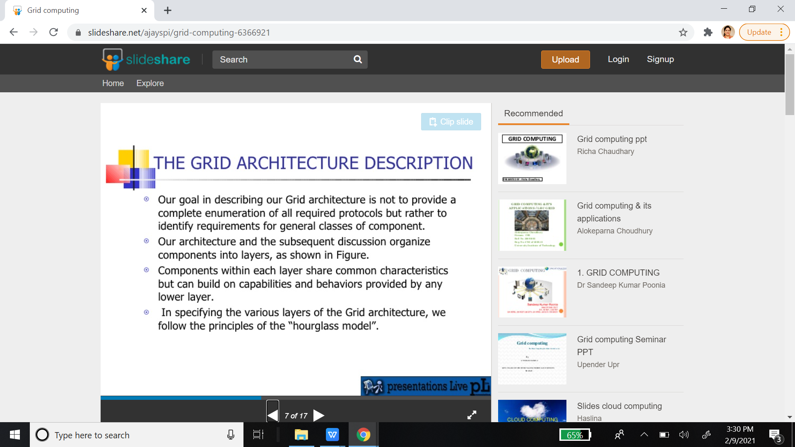

Slide 33
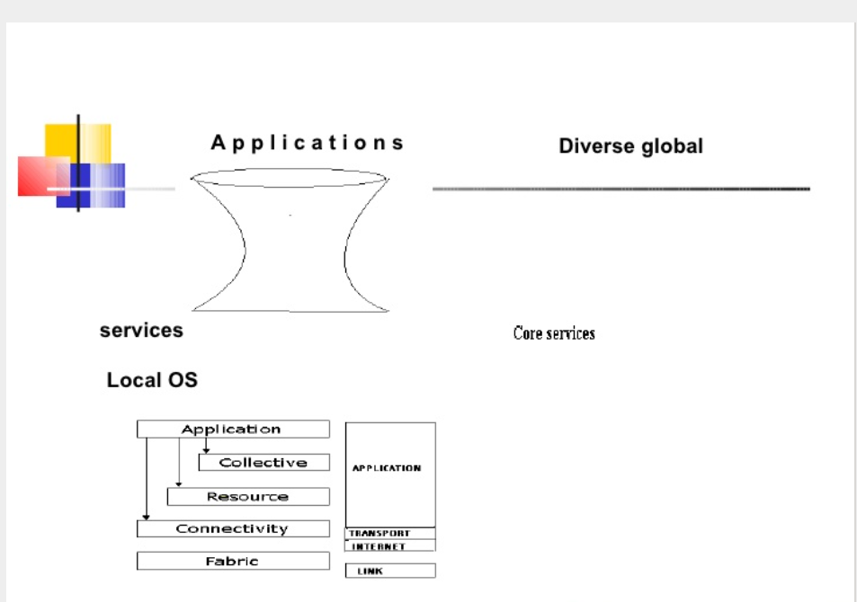

Slide 34
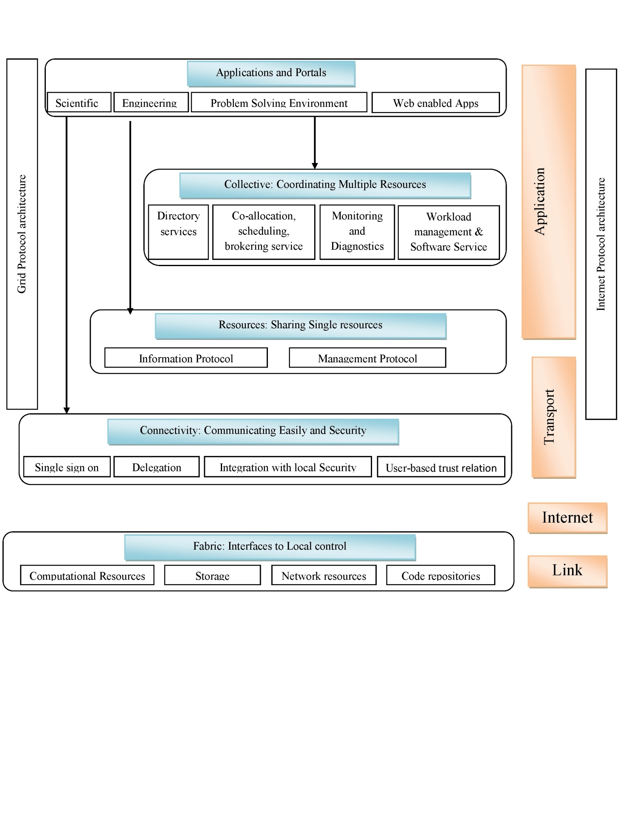
Architecture of Grid

Slide 35
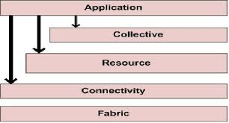
Grid Computing
Layers of Grid System architecture are as follows:
(i)Fabric Layer: Lowest layer
It comprises geographically distributed and sharable resources such as storage devices, computing devices, high bandwidth networks and scientific instruments, etc.
These resources are accessible from anywhere in the internet.
(ii)Connectivity Layer:
It provides an easy and secure access to the resources through some standardized protocols.
The authentication protocols are used to provide proper verification of users and resources.
The communication protocols provide a mechanism for transmission of data between the fabric and the resource layer.

Slide 36
Cont ...
(iii)Resource Layer:
It specifies the necessary protocols to operate among shared resources.
It is primarily built upon the communication and authentication protocols of connectivity layer.
It defines the APIs (Application Program Interfaces) and SDK (Software Development Kit) to make secure the initiation, accounting, negotiation, controlling and monitoring of resources.
(iv)Collective Layer:
It is used for common functional utilities.
The operations such as collaboration among the shared resources are performed in this layer.
It provides services like brokering, monitoring, scheduling, discovery, replication and co-allocation etc.

Slide 37
Grid Computing
(v)Application Layer:
This layer offers communication interfaces to the users and the administrators for interacting with the Grid.

Slide 38
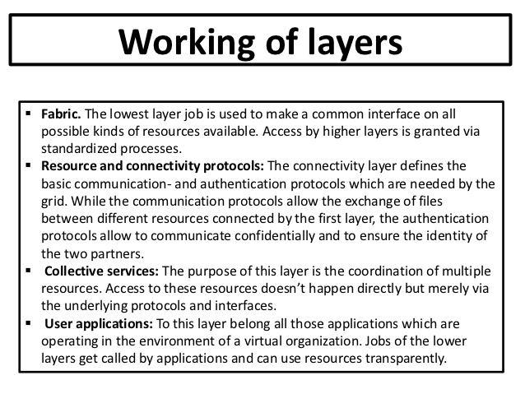

Slide 39
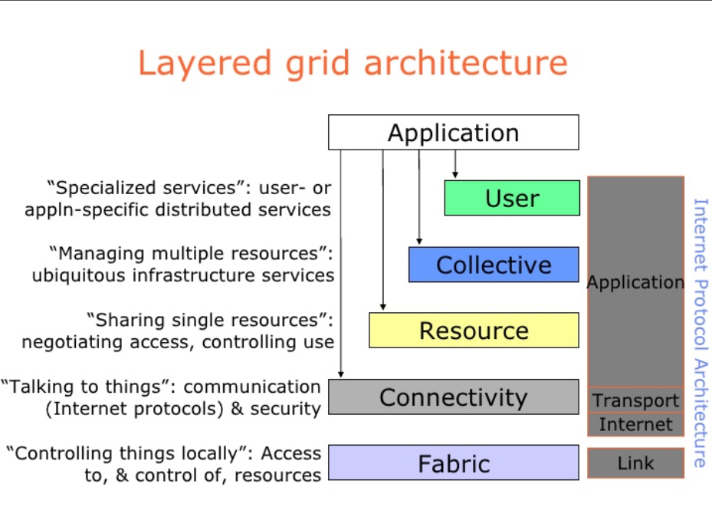

Slide 40
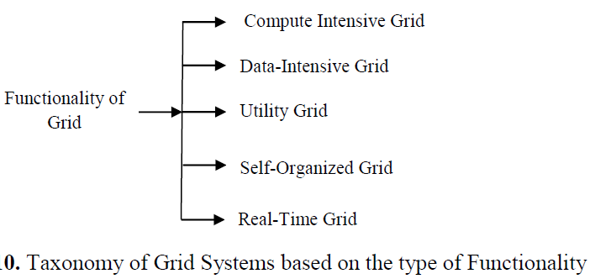
Types of Grid Systems

Slide 41
Types of Grid Systems
Compute Intensive:
Major functionality of this Grid is to offer powerful CPU resources, whereas other characteristics are trivial.
It intends to provide aggregated CPU cycles of several resources for fulfilling computational need of a particular application.
Data-Intensive Grid:
It offers large storage space for data discovery, data management and data processing.
Utility Grid:
It pools dynamically available resources to match the requirements of the applications.
This enables the Utility Grid to provide services that cannot be provided by any single machine.

Slide 42
Cont ...
Self-Organized Grid:
Grid management is extremely challenging due to its complex dynamic environment.
However, Self-Organized Grid includes some intelligence embedded into its infrastructure to automate its control, organization, and monitoring procedure.
It can heal itself in changing and uncertain environments for maximizing reliability and resource utilization.
Real Time Grid:
Traditional Grid could not support certain requirements of many real time applications.
Technological advancement with increasing number of real time applications initiated the emergence infrastructure that can deal with the rich variety of real time interactions between the users and the applications through virtual workspace.
Therefore, Grids that support Real time applications such as disaster management, e-healthcare, e-learning etc. can be termed as Real-Time Grid.

Slide 43
Examples
a) Health
World Community Grid
World Community Grid’s mission is to create the largest public computing grid benefiting humanity, which is funded and operated by IBM. Using the idle time of computers around the world, World Community Grid’s research projects have analyzed aspects of the human genome, HIV, dengue, muscular dystrophy, and cancer.
B) Engineering Design
Analysis of real-time data to find a particular pattern.
• Experiment modeling to create new designs.
• Verifying existing models for accuracy using simulation activities.
C) Grid Computing in Government
C-DAC launched the Indian National Grid Computing Initiative - GARUDA, with a vision to facilitate solutions to scientific, engineering and socio-economic development. GARUDA is a collaboration of scientific and technological researchers on a nation wide grid comprising of computational nodes, mass storage and scientific instruments. The aim is to provide the technological advances required to enable data and compute intensive science and engineering applications for the 21st Century.
D) Education, Science and beyond
SETI (Search for Extraterrestrial Intelligence) @Home project
SETI@home is a scientific experiment that uses Internet-connected computers in the Search for Extraterrestrial Intelligence (SETI). You can participate by running a free program that downloads and analyzes radio telescope data.
Education - e-learning
E) Grid Computing in the Movie Industry
Many films can’t be made without the use of grid computing not only because of special effects but also because of the fact that grid computing enables faster production of a film.
Grid computing is an enhancement tool for the studios.

Slide 44
Mobile Computing
Mobile Computing is a technology that allows transmission of data, voice and video via a computer or any other wireless enabled device without having to be connected to a fixed physical link. The main concept involves −
Mobile communication
Mobile hardware
Mobile software

Slide 45
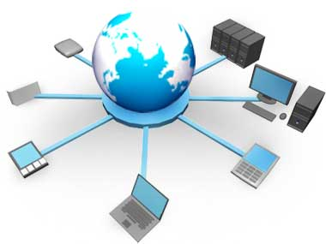
Mobile Computing
The mobile communication in this case, refers to the infrastructure put in place to ensure that seamless and reliable communication goes on. These would include devices such as protocols, services, bandwidth, and portals necessary to facilitate and support the stated services. The data format is also defined at this stage.

Slide 46
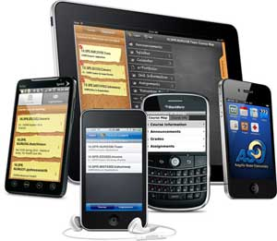

Mobile Computing
Mobile Hardware
Mobile hardware includes mobile devices or device components that receive or access the service of mobility. They would range from portable laptops, smartphones, tablet Pc's, Personal Digital Assistants.
Mobile software
Mobile software is the actual program that runs on the mobile hardware. It deals with the characteristics and requirements of mobile applications. This is the engine of the mobile device. In other terms, it is the operating system of the appliance. It's the essential component that operates the mobile device.

Slide 47
What is Cloud Computing?
Cloud Computing is a general term used to describe a new class of network based computing that takes place over the Internet,
  basically a step on from Utility Computing
  a collection/group of integrated and networked hardware, software and Internet infrastructure (called a platform).
  Using the Internet for communication and transport provides hardware, software and networking services to clients

Slide 48
Contd..
  These platforms hide the complexity and details of the underlying infrastructure from users and applications by providing very simple graphical interface or API
  The platform provides on demand services, that are always on, anywhere, anytime and any place.
  Pay for use
  Scalable as needed
  -scale up and down in capacity and functionalities
The hardware and software services are available to general public, enterprises, corporations and businesses markets

Slide 49
Difference between cluster and cloud computing (SCHOL)
Spanning area -Cluster is a group of computers connected by a local area network (LAN), whereas cloud and grid are more wide scale and can be geographically distributed.
Coupling - cluster is tightly coupled, whereas a grid or a cloud is loosely coupled.
Homogeneity -clusters are made up of machines with similar hardware, whereas clouds and grids are made up of machines with possibly very different hardware configurations.
Ownership: A grid is a collection of computers which is owned by multiple parties in multiple locations. Whereas a cloud is a collection of computers usually owned by a single party.
Load distribution: In cluster the load is distributed among all nodes but in case of Cloud, the resources are allocated as per the request. The whole data center is not occupied by one job.

Slide 50
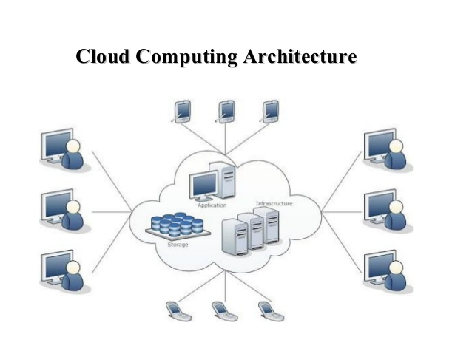
What is Cloud Computing?
  Cloud computing is an umbrella term used to refer to Internet based development and services

Slide 51
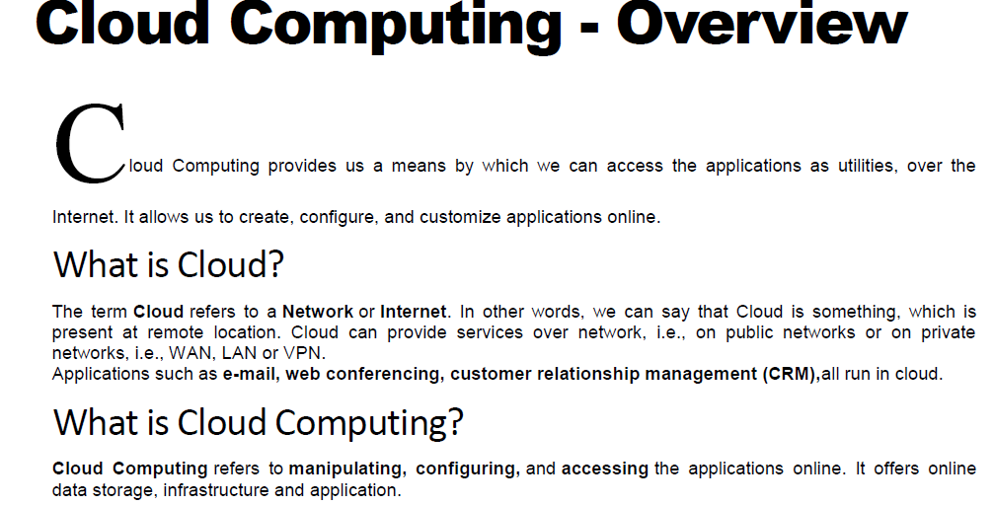

Slide 52
We need not to install a piece of software on our local PC and this is how the cloud computing overcomes platform dependency issues. Hence, the Cloud Computing is making our business application mobile and collaborative.

Slide 53
Basic Concepts
There are certain services and models working behind the scene making the cloud computing feasible and accessible to end users. Following are the working models for cloud computing:
Deployment Models
Service Models
DEPLOYMENT MODELS
Deployment models define the type of access to the cloud, i.e., how the cloud is located? Cloud can have any of the four types of access: Public, Private, Hybrid and Community

Slide 54
Deployment Models
The Public Cloud allows systems and services to be easily accessible to the general public. Public cloud may be less secure because of its openness, e.g., e-mail.
The Private Cloud allows systems and services to be accessible within an organization. It offers increased security because of its private nature.
Cummunity Cloud -The Community Cloud allows systems and services to be accessible by group of organizations.
The Hybrid Cloud -is mixture of public and private cloud. However, the critical activities are performed using private cloud while the non-critical activities are performed using public cloud.

Slide 55
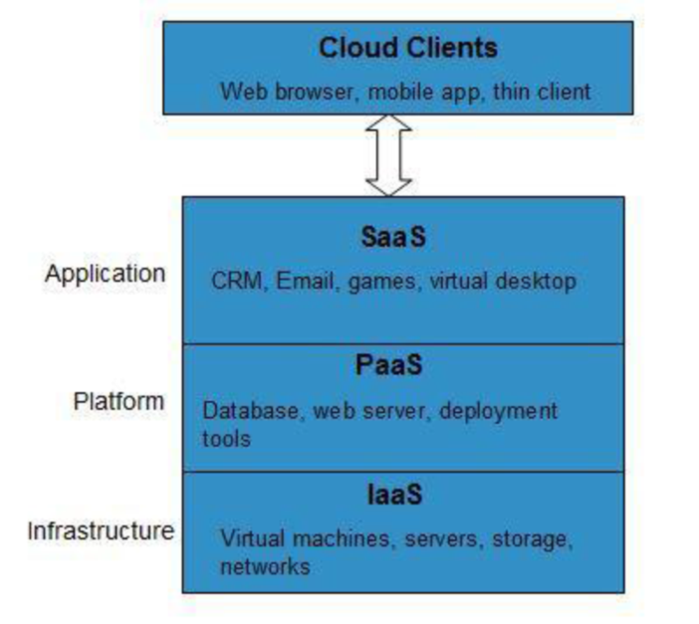
Service Models
INFRASTRUCTURE AS A SERVICE (IAAS)
IaaS provides access to fundamental resources such as physical machines, virtual machines, virtual storage, etc.
PLATFORM AS A SERVICE (PAAS)
PaaS provides the runtime environment for applications, development & deployment tools, etc.
SOFTWARE AS A SERVICE (SAAS)
SaaS model allows to use software applications as a service to end users

Slide 56
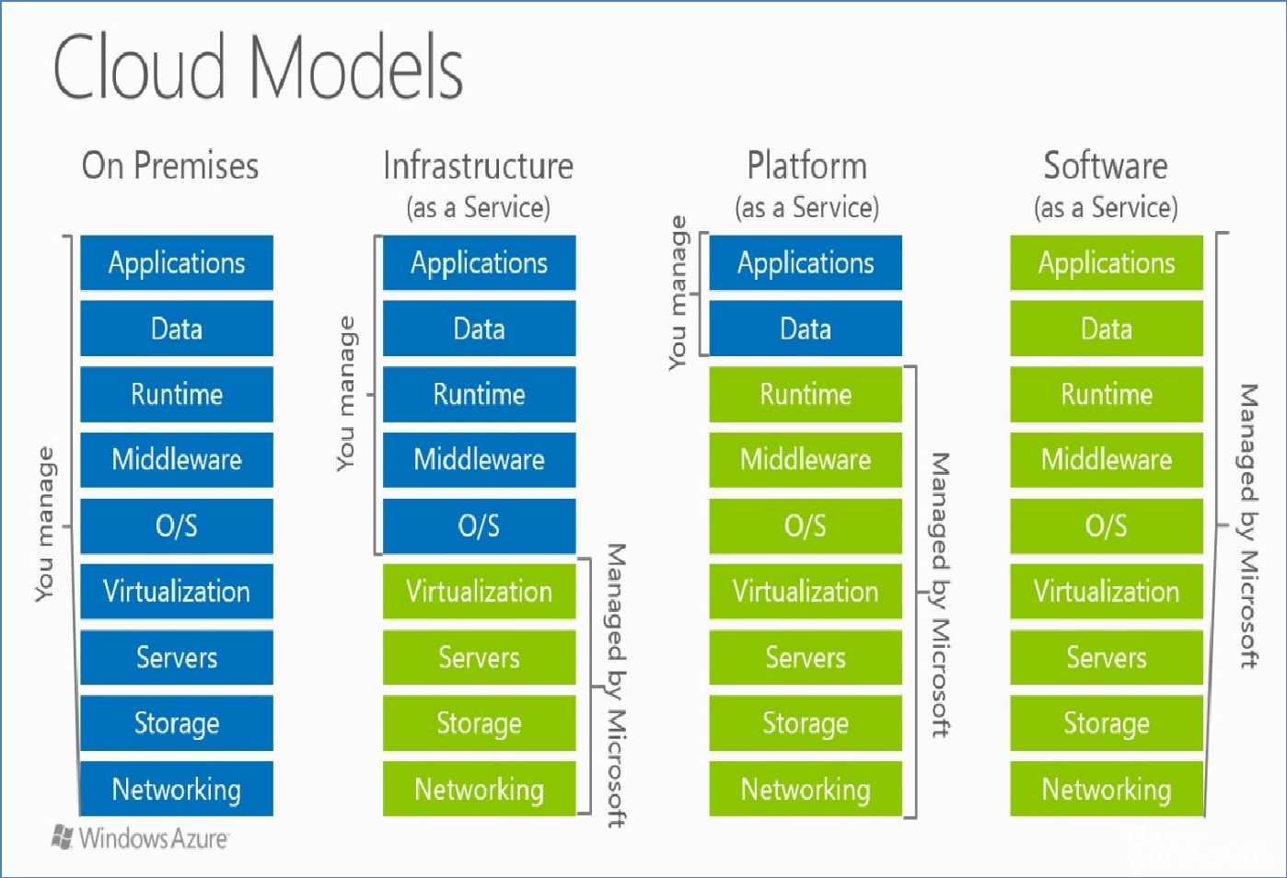

Slide 57
Benefits

